Slide 1

Constitutive Models for viscoelasticity
Presented by:
Ayush Tripathi
Under the guidance of
Dr Prakhar Gupta
Department of Mechanical & Aerospace Engineering

Slide 2
Index
Framework
Internal variable model
Continuum mechanics model
Rheological model
Strain energy density functions
Micro macro model
Statistical mechanics framework
Honeywell project
Roadblocks
course of action

Slide 3
Introduction
Development of constitutive models based on two approaches
Continuum Mechanics framework
Internal variable
Thermodynamic variable
Statistical Mechanics framework
Micro-mechanism

Slide 4
Continuum mechanics framework
Also referred as phenomenological models.
Such models assume that the hyperelastic properties can be described by means of a strain energy density function that involves either strain invariants or principal stretches.
All hyperelastic material models are based on a strain energy function that determines how much energy is stored in the material as a function of the applied deformation
Since the energy must be independent of rigid body rotations, the strain energy function is often written in terms of its invariants
Lack microstructural justification

Slide 5
Statistical mechanics framework
Directly link the macroscopic behavior of the materials to their microstructure.
The parameters of polymer physics and chemistry, such as the cross-linking density, the molecular weight of the monomers, the chain extensibility, the polymerisation degree and the amount of entanglements of polymer chains, reflect the microstructure of the material
Micro-mechanical based hyperelastic models
Preserve the affinity of network deformation induced by the macroscopic deformation
Affine network models fail to fully capture the entanglement effect of polymer chains, hence cannot represent the real molecular structure of the elastomers.

Slide 6
Constitutive models with Internal variables
Current state of thermoelastic material
F and θ
Measurable and controllable (External variable)
Material involving dissipation
Internal variable
Describes aspects of the internal structure of a material
History variable for dissipative materials
Thermodynamic state variable ζ
Current state of dissipative material : F, θ, ζ

Slide 7
Constitutive models with Internal variables
Current thermodynamic state: fictitious state of thermodynamic equilibrium described by their current value and not by their past history
phenomenological variable constructed mathematically(Thermal, chemical, mechanical)
Describe structural property within a macroscopic framework
Dashpot displacement in viscoelastic models
Damage, inelastic strains, dislocation densities
The existence of non-equilibrium states that evolve with time is an essential feature of inelastic materials
A viscoelastic behaviour of a material is characterised by hysteresis

Slide 8
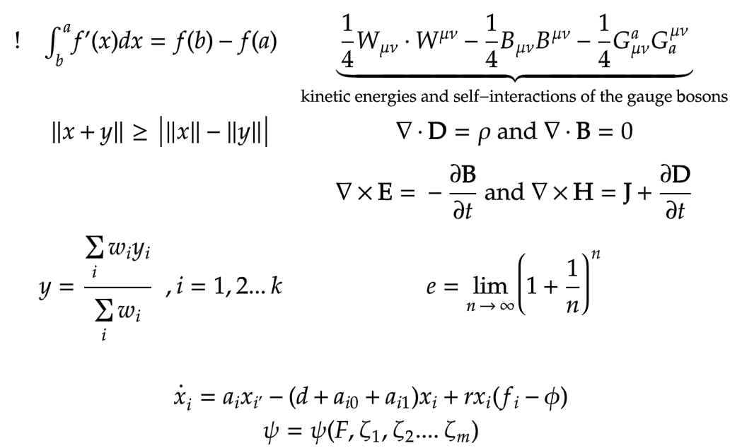
Isothermal framework
Hemholtz free energy function defines the thermodynamic state by
Deformation Gradient (F)
Internal history variable specified for a particular problem
Number of variables depend on theory and boundary condition

Slide 9
Constraints on constitutive law
it is essential to make sure that the stress-strain law satisfies two conditions:
(i) It must obey the laws of thermodynamics.
(ii) It must satisfy the condition of objectivity, or material frame indifference.
Thermodynamic restrictions: The laws of thermodynamics impose two restrictions on stress-strain laws:
The first law requires that the work done by stresses must either be stored as recoverable internal energy in the solid, or be dissipated as heat (or a combination of both).
The second law requires that if a sample of the material is subjected to a cycle of deformation that starts and ends with an identical strain and internal energy (at constant temperature, or without heat exchange with the surroundings) the total work done must be positive or zero.

Slide 10


Constraints on constitutive law
For purely mechanical theory
Local entropy production must always be greater than zero
Work conjugate pair; rate of internal mechanical work per unit volume (stress power)
Rate of change of internal energy

Slide 11
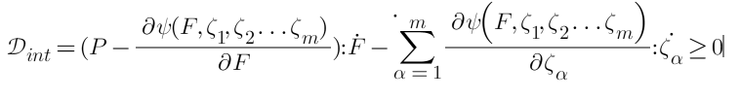
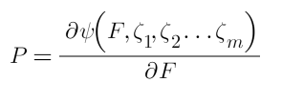

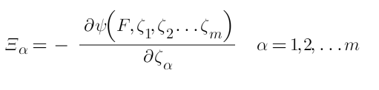


Internal variable model
Splitting the terms
Gradient of free energy wrt to internal variable
Must hold for all times at every point of the continuum body
Conjugate to
Tensor variables F and are associated with thermodynamics forces P and
If is not needed to characterize thermodynamic state of the system, then the material is perfectly elastic
Notes:
281

Slide 12

Kinetic Relation
Describes the evolution of the internal variable and associated dissipation mechanism
Required to describe how an irreversible process evolves
Thermodynamic admissibility is the only restriction
Rate at which the internal variables tend towards equilibrium
Tensor valued function with 1+m variables
Every system tends to thermodynamic equilibrium
Observable and internal variable reach equilibrium under prescribed stress and strain
Remain constant at all points if the system with time
For an elastic continuum, every state is in equilibrium

Slide 13
Viscoelastic material at large strains
Process involving relaxation and creep
Non equilibrium thermodynamics
Thermoplastic elastomers
Thermodynamic state is characterized by internal variables
External variables not suitable for finite element realization
3D viscoelastic model for finite strains and small perturbations away from equilibrium
Not restricted to isotropy

Slide 14




Viscoelastic material at large strains
Decoupled representation of Helmholtz free energy function
Dialational
Isochoric
Change of free energy within an isothermal framework given by
Normalization condition
Equilibrium state
Configurational

Slide 15


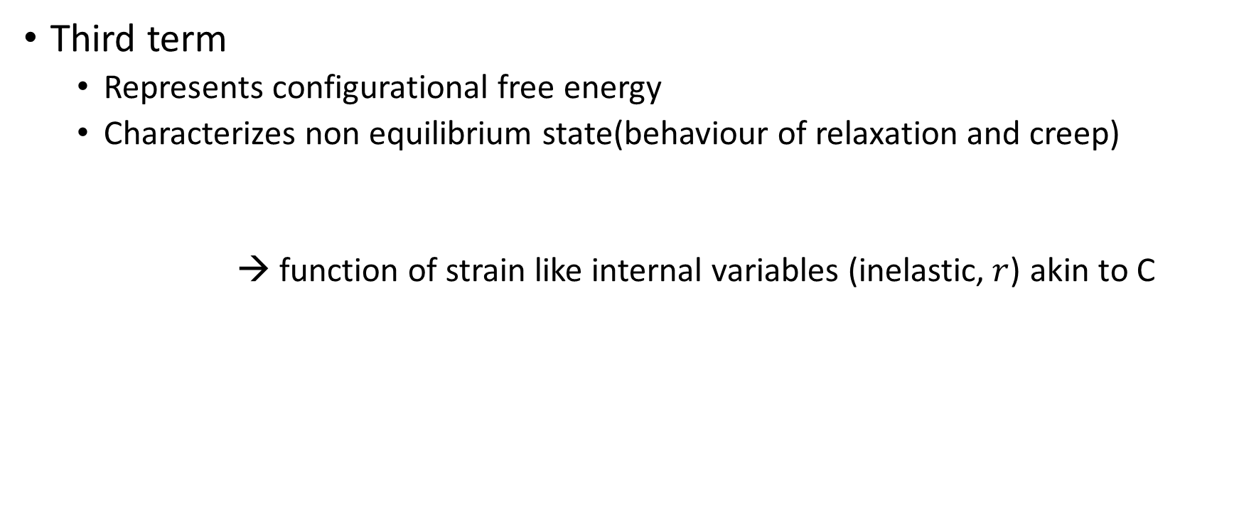
Viscoelastic material at large strains
Third term
Represents configurational free energy
Characterizes non equilibrium state(behaviour of relaxation and creep)
→ function of strain like internal variables (inelastic,$r$) akin to C

Slide 16





Decoupled volumetric-isochoric State
Second Piola-Kirchoff
Additive decomposition
Where,
Q represents non-equilibrium stresses in the sense of non-equilibrium thermodynamics
P is the projection tensor

Slide 17



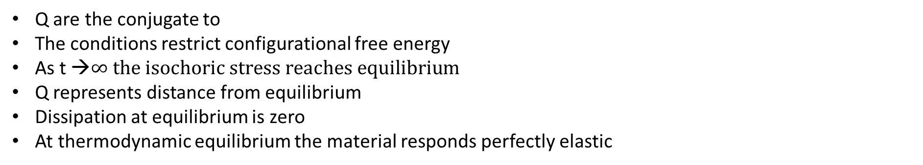
Viscoelastic material at large strains
Equilibrium
Non-Equilibrium
Q are the conjugate to
The conditions restrict configurational free energy
As t →$∞ the isochoric stress reaches equilibrium$
Q represents distance from equilibrium
Dissipation at equilibrium is zero
At thermodynamic equilibrium the material responds perfectly elastic
Fictitious Non Equilibrium Stress

Slide 18
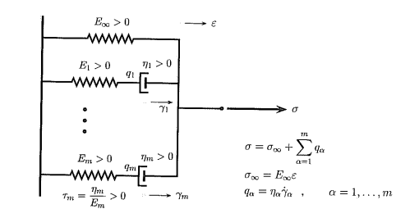





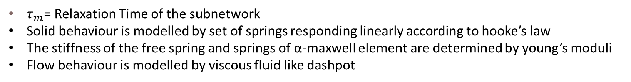
Rheological models
Total Stress applied
→Total linear strain due to strain
→inelastic strain(internal variable)
→Strain rate
→Viscosity
-
→Non equilibrium stress(internal variable) at each dashpot
$τ_{m}$= Relaxation Time of the subnetwork
Solid behaviour is modelled by set of springs responding linearly according to hooke’s law
The stiffness of the free spring and springs of α-maxwell element are determined by young’s moduli
Flow behaviour is modelled by viscous fluid like dashpot

Slide 19





Rheological models
The Mechanical device is assumed to have unit area and unit length
Stress and strain interpreted as force and extension
Total stress applied
@ equilibrium
Stress in the spring of α-maxwell element
Stress acting on each dashpot
Differentiating, we get

Slide 20

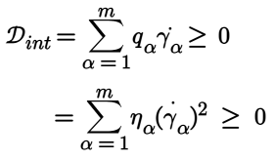
Thermodynamic Admissibility
→ stress on each dashpot
→ strain rate on each dashpot
Always non-negative
Condition for Thermodynamic admissibility of non-equilibrium stress

Slide 21





Stress Decomposition
Defining Strain energies
Where, the quadratic forms
Normalization condition

Slide 22





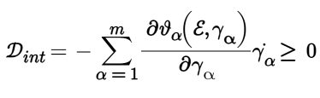

Stress Decomposition
→ Energy stored elastically in springs
→Viscoelastic contribution to strain energy and is related to relaxation(retardation) process with relaxation time${(τ}_{α})$
Differentiating ($ψ$) wrt total strain ($ε$) gives the total stress ($σ$) applied
Linear Stress
Non-Linear Stress
The internal dissipation becomes

Slide 23



Evolution Equation
Necessary to specify complementary equations of evolution
Describes evolution of a viscoelastic process
Local entropy production inequality is satisfied
Law needs to govern internal variable
-- Isochoric non-equilibrium stress
Evolution equation needs to have physical basis
Should be suitable for time integration algorithm
Good approximation to the observed physical behaviour for large strain

Slide 24





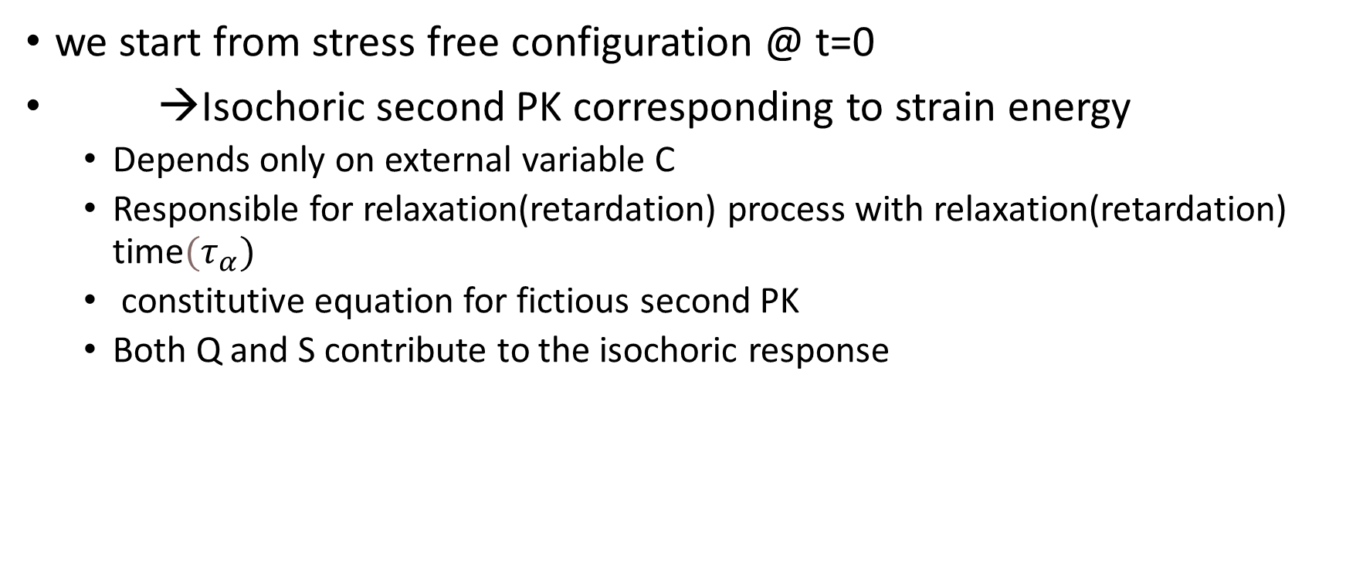
Evolution Equation
we start from stress free configuration @ t=0
→Isochoric second PK corresponding to strain energy
Depends only on external variable C
Responsible for relaxation(retardation) process with relaxation(retardation) time${(τ}_{α})$
constitutive equation for fictious second PK
Both Q and S contribute to the isochoric response

Slide 25
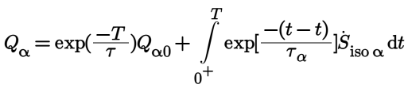


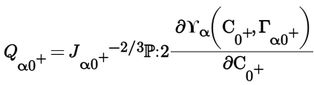

Solution to linear evolution equation
Solution to the evolution equation valid for semi-open interval
Instantaneous response is given by
Evolution of internal variable is governed by strain energy density function

Slide 26



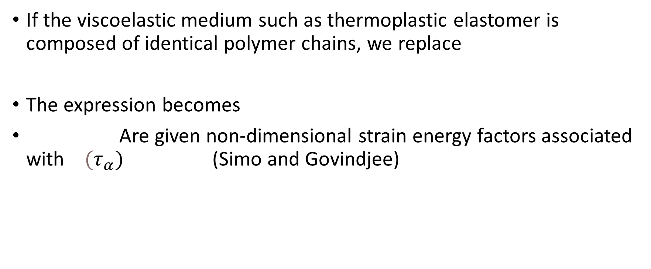
Solution to linear evolution equation
If the viscoelastic medium such as thermoplastic elastomer is composed of identical polymer chains, we replace
The expression becomes
Are given non-dimensional strain energy factors associated with ${(τ}_{α})$ (Simo and Govindjee)

Slide 27



Time integration algorithm
Cauchy’s equation of motion
We need an update algorithm to obtain total stress
Update procedure recognized in reference configuration
Numerical integration of convolution integral
Algorithmic update of the second Piola Kirchhoff stress S
Time discretization of the closed time interval

Slide 28


Time integration algorithm
For a time sub interval
Assuming that upto a certain time , the stress S_{n} , satisfies the equilibrium equation and displacement field U_{n}
F_{n} = I + Grad U_{n} J_{n}= det F_{n}
C_{n}= F_{n}^{T} F_{n} C _{n}= J_{n}^{-2/3} C_{n}
S_{n→} Determined previously
Are specified uniquely by a given motion X_{n} at time
Strain driven type of numerical procedure

Slide 29

Time integration algorithm
We advance the procedure to time
Update all relevant quantities
Make an initial guess X_{n+1} → trial solution
Update all prescribed loads
The new motion X_{n+1} at time t_{n+1} is corrected iteratively until all balance principles are satisfied
To check equilibrium at t_{n+1} all the tensor variables are updated
F_{n+1} = I + Grad U_{n+1} J_{n+1}= det F_{n+1}
C_{n+1}= F_{n+1}^{T} F_{n+1} C _{n+1}= J_{n+1}^{-2/3} C_{n+1}

Slide 30


Time integration algorithm
S_{n+1} at t_{n+1} is determined uniquely via associated constitutive relation
All strain measures are known at t_{n+1}

Slide 31

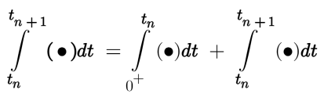
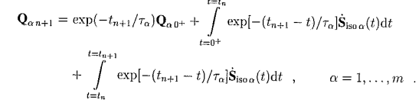
Time integration algorithm
For using the approach followed by (Simo 1987), which bypasses the need for incremental objectivity (frame indifference) during superimposed rigid body motion
Splitting the convolution integral

Slide 32




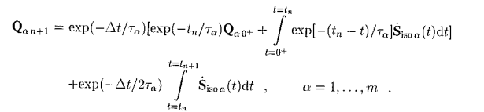
Time integration algorithm
To simplify we substitute
takes values and
Using second order accurate mid point rule on the third term

Slide 33


Time integration algorithm
Rearranging and substituting we get,
where
Dimensionless parameter
History term determined by Q and S from previous iteration.

Slide 34
Micro mechanical based model
Elastomers consist of polymer networks formed by the cross-linking of highly mobile and flexible polymer chains
typically characterized by their high compliance and capability of sustaining large deformation
Non linear stress behaviour
Sustain strain upto few hundred percent (Hyperelasticity)
Rate dependent behaviour(viscoelasticity)
Decompose stress
Elastic + Inelastic

Slide 35
Micro mechanical based model
Phenomenological model
Properties of material defined using strain energy density function
Strain invariants and principal stretches
Models sufficient to describe empirical relationship between stress and strain
Lack microstructural justification

Slide 36
Micro mechanism model
Directly link macroscopic behaviour to their microstructure
Considering parameters of polymer physics and chemistry
Cross-linking density
Molecular weight of monomers
Chain extensibilty
Polymerization degree
Amount of entanglement of polymer chains
Gaussian: chain length <<< extension limit
Non-gaussian: chain length approaches maximum extension
Fail to capture entanglement effects of chain

Slide 37
Multiplicative decomposition of deformation gradient
Stress or strain like internal variable
Similar to finite deformation plasticity
Multiplicative decomposition of deformation gradient
Microstructure details are not reflected by the material parameter
Capable of qualitatively predicting
Time dependent inelastic deformation
Stress response of elastomers
Distinguish between them by
Numerical modelling on macroscopic viscoelastic behaviour
Fitting to experimental behaviour
Lack underlying physical mechanism of viscoelasticity

Slide 38
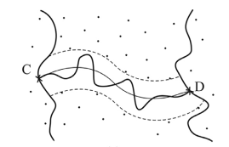
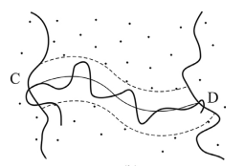
Polymer Dynamics: Tube model
Cross Linked with chains at C and D
Entanglement with chains at C and D
Topological constraint: Polymer chain is confined in a tube like region
Primitive chain: Axis of tube confining chain C-D

Slide 39
Polymer Dynamics: Tube model
For short time scales
motion of polymer chain can be considered as wriggling around its primitive chain
Wriggling represented by
Dia of tube
Contour length of primitive chain
Motion forgotten once parameters are defined
For long time scales
Polymer chain reptates along the tube
Destroying and creating ends of the tube

Slide 40
Polymer Dynamics: Tube model
Under deformation
Ground network sustains elastic stress
Inelastic stress is generated by reptation
Dia of tube changes significantly
Affects the reptation ability and hence relaxation process
Needs to be developed statistically
All parameters have microscopic foundation
Obtained by fitting experimental data/ simulation
cannot be used to capture the energy dissipation during finite deformation

Slide 41
Micro macro constitutive model
Micro macro constitutive model
Combines continuum mechanics and statistical mechanics
Incorporates non-linear viscosity into state of art continuum mechanics
Adopts thermodynamic evolution model
adopts most of the hyperelastic constitutive equations
Captures the relaxation and non-linear viscosity of polymer chains under large deformations
Insights into tailoring the microstructure to application

Slide 42

Continuum mechanics Framework
Elastic ground network
Subnetwork of different types of polymer chains
Each subnetwork represents a type of polymer chains with similar diffusion behaviour
Subnetworks B₁ –B_{m} relax with time and dissipate energy
Deformation gradient is
Since deformation acts on all the polymer network

Slide 43
Continuum mechanics Framework
For each subnetwork, F can be decomposed into
Elastic Component
Inelastic component
→ Deformation gradient of the spring
→ Deformation gradient of the damper in the subnetwork

Slide 44




Continuum mechanics Framework
& Helmholtz free energy densities of the spring in ground and sub network respectively
Total free energy density of the elastomer
Cauchy stress tensor is given by

Slide 45


Continuum mechanics Framework
Where,
First piola Kirchoff stress tensor is given by

Slide 46



Thermodynamic requirement
free energy of a material system must never increase under isothermal conditions.
internal variables of the time-dependent polymer networks must fulfil the entropy inequality
Even when the system is in a non-equilibrium state

Slide 47



Internal variable evolution equation
We know that
Material time derivative of internal variable,
Where,
Load is applied simultaneously to all networks simultaneously
Relaxation of different subnetwork is independent of each other
Notes:
Coleman and gurtin

Slide 48
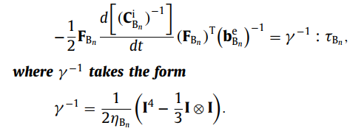
Thermodynamic admissibility
A sufficient condition for fulfilling the inequality is that the internal variable satisfy the thermodynamic evolution equation
Notes:
From(using) kinetic relation slide 7, time

Slide 49

Rivlin-Mooney
Linear dependence on first and second invariance
applicable for small strains only
Cannot capture strain hardening or softening
Lack of frequency dependence
Parameters lack physical basis

Slide 50

Neo-Hookean Model
µ and k are material parameters
For small strain, they are shear and bulk modulus respectively
µ =NkT; where N is the number of polymer chains per unit volume, k is the Boltzmann constant, and T is temperature.
Limited compressibility
Does not account for variation in Material parameters with strain rate
Not suitable for finite deformation

Slide 51


Ogden
Stretch based
Modified principle stretches associated with volume changing deformations
Choices of independent variable complicate the mathematical analysis associated with it
Versatile (compressible and incompressible material)
Highly parameterisable
Suitable for finite deformation; high strain range
Limited capture of nonlinearities
Parameters does not have physical basis
Can be reduced to Rivlin-Mooney

Slide 52
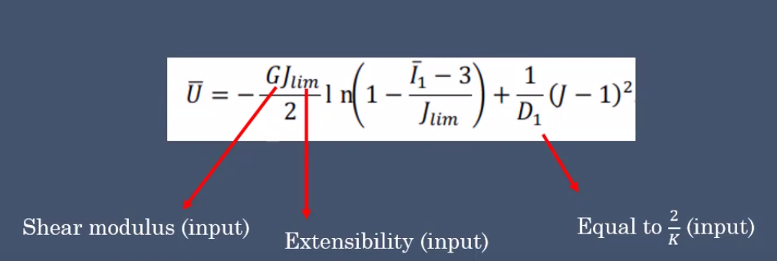
Gent
Singularity when the first invariant of the left Cauchy-Green deformation tensor reaches a limiting value
Finite stretchability
Accounts for chain extensibility

Slide 53

Stress-strain relation

Slide 54



Non-linear viscosity of free chains
The viscosity of subnetwork Bn must be constitutively prescribed to obtain inelastic deformation
viscosity of a polymer network can be expressed in terms of the shear relaxation modulus Gn
Relaxation of elastomers originate from the polymer chains

Slide 55

Non-linear viscosity of free chains
For short time scale(t<te)
Diffusion of the polymer chain can be represented as Brownian motion
For (t=te)
Brownian motion restricted by topological constraint (tube region)
For (t>te)
Due to restriction on the tube, the polymer chain starts to reptate and disengages from the original tube
Assuming smooth transition from rouse behaviour to reptation behaviour, G in terms of polymer structure parameter

Slide 56
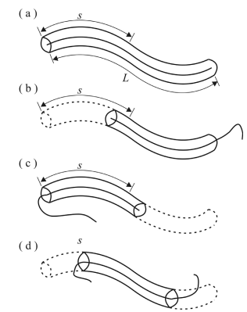

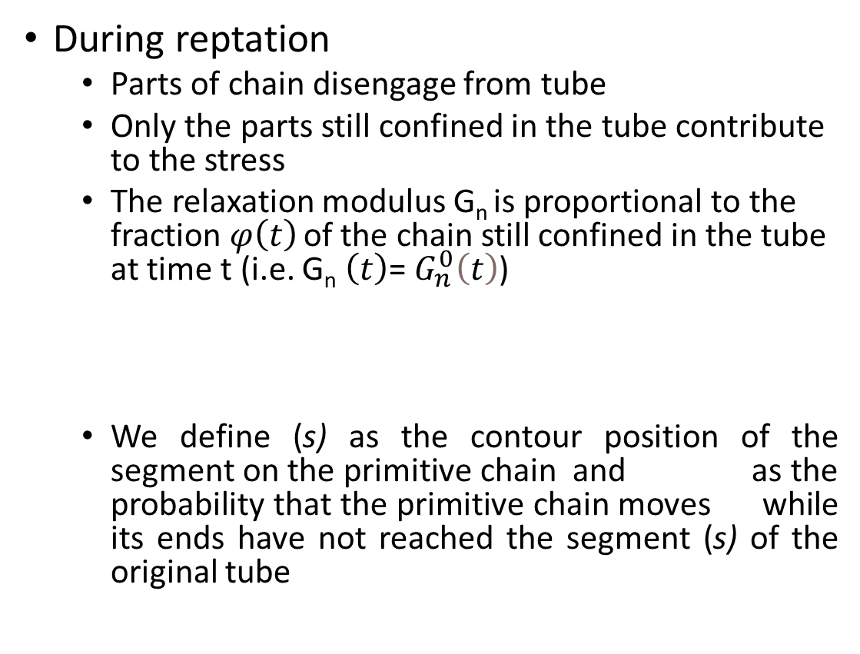
Non-linear viscosity of free chains
During reptation
Parts of chain disengage from tube
Only the parts still confined in the tube contribute to the stress
The relaxation modulus G_{n} is proportional to the fraction $φ\left(t\right)$ of the chain still confined in the tube at time t (i.e. G_{n} $\left(t\right)$= $G_{n}^{0}\left(t\right)$)
We define (s) as the contour position of the segment on the primitive chain and as the probability that the primitive chain moves while its ends have not reached the segment (s) of the original tube

Slide 57



Non-linear viscosity of free chains
must satisfy the one dimensional diffusion equation
D_{c} is the diffusion coefficient of the polymer chain
When ξ = s, segment s disengages from the original tube and
Similarly when ξ = s-L, where L is contour length of the primitive chain at time t
The solution using the boundary conditions

Slide 58





Non-linear viscosity of free chains
Where is the disengagement time of the free chain
Time needed for complete disengagement of the polymer chain from the tube it is confined or finish the relaxation process
Fraction of chain confined in the tube at time (t)
Combining, we get
where
→ Tube diameter
→monomer friction coefficient
→Polymerisation degree of network
b_{o} →effective bond length between monomers

Slide 59


Non-linear viscosity of free chains
of the tube and primitive chain length are assumed to be unchanged under deformation (Doi and Edwards 1986)
Which yields a constant
Works well for small deformations
To capture the nonlinear viscosity under finite deformation
The primitive chain length L must change with macroscopic deformation
Average over all possible initial tangent vectors u₀ is formulated as
The mean diameter (a_{n})also changes with deformation
Linked to mean square end-to-end distance of the primitive chain
Assumptions have been verified using molecular dynamics simulation

Slide 60

Non-linear viscosity of free chains
In this model, the disengagement time in the equation of viscosity varies with macroscopic deformation
Leading to non-linearity of viscosity
Here, the mean square end-to-end distance of the primitive chain is calculated as
f₀(R) is the statistical distribution function on end-to-end vector R of the primitive chain in reference state

Slide 61





Non-linear viscosity of free chains
Assumed that the primitive chain in the current state is deformed in the same way as the microscopic deformation therefore,
a₀= diameter in the primitive chain
= mean square end-to-end vector of the primitive chain in the reference state
Substituting in the equation for non-linear viscosity
Viscosity in reference state
Dimensionless parameter

Slide 62


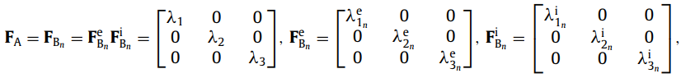
Numerical simulations
Helmholtz free energy density functions must be specified first
Governed by elastic ground network of the polymer
Should be able to capture elastic response of the elastomer
Material parameters can be obtained by fitting them to quasi-static experiments
The material parameters of can be be determined by fitting them to loading-unloading experiments conducted at different strain rates
Considering homogenous isochoric deformation

Slide 63
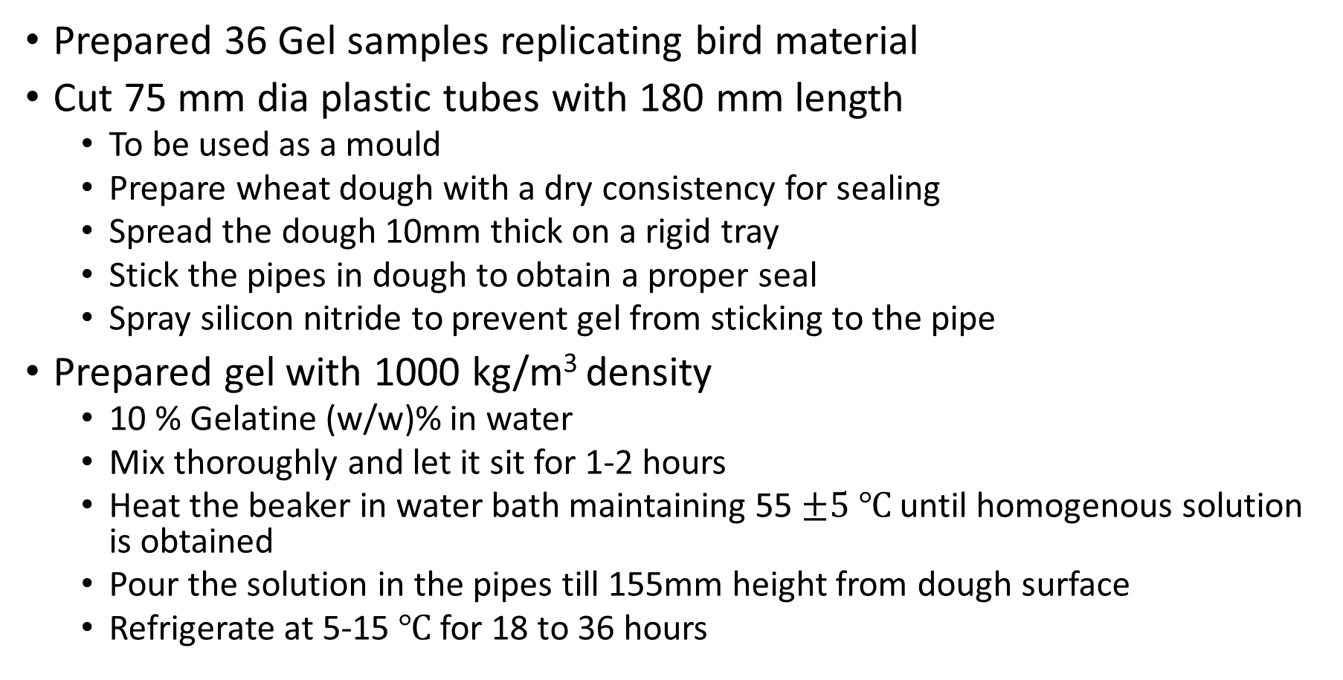
Honeywell project: Gel preparation
Prepared 36 Gel samples replicating bird material
Cut 75 mm dia plastic tubes with 180 mm length
To be used as a mould
Prepare wheat dough with a dry consistency for sealing
Spread the dough 10mm thick on a rigid tray
Stick the pipes in dough to obtain a proper seal
Spray silicon nitride to prevent gel from sticking to the pipe
Prepared gel with 1000 kg/m³ density
10 % Gelatine (w/w)% in water
Mix thoroughly and let it sit for 1-2 hours
Heat the beaker in water bath maintaining 55 $±5 ℃$ until homogenous solution is obtained
Pour the solution in the pipes till 155mm height from dough surface
Refrigerate at 5-15 $℃$ for 18 to 36 hours

Slide 64
Setup
Mould removal
Dip the cast in warm water briefly
Use a long thin metal wire to slowly debond the curved surface of the pipe
Gently apply pressure from free end to obtain the required gel cylinder
Helped in the initial setup of the
Strain gauge
Gas gun
Barrel
Momentum trap

